Slide 1
EECS-731 Understanding climate change with data-science
Team Oracle
Austin Adams
Pushkar Singh Negi
Ravali Kondreddi
Ronald Moore
Waqar Ali

Slide 2
Introduction
What is this project about?
What is climate-change?
Make hypothesis about factors which cause climate-change
Consumption of fossil-fuels
Emission of CO₂
Population increase
Melting of polar ice-caps
Emission of Ozone depleting substances

Slide 3
Introduction
Role of Data-Science
Identify if we can correlate the trends in the identified factors over the years with climate-change trend
Use classification / clustering techniques to make predictions
Explore the occurrence of natural disasters in the last century
Correlate with climate change trend
Use time-series forecasting to predict future disaster trend

Slide 4
“ Climate change is a change in the statistical distribution of weather patterns when that change lasts for an extended period of time .”
Wikipedia

Slide 5
Data Exploration

Slide 6
Global Temperature
Features
Timestamp
Average Land Temperature (TempLand)
Uncertainty in Average Land Temperature
Max Land Temperature
Uncertainty in Max Land Temperature
Average Land and Sea Temperature (TempGlobal)
Uncertainty in Average Land and Sea Temperature

Slide 7
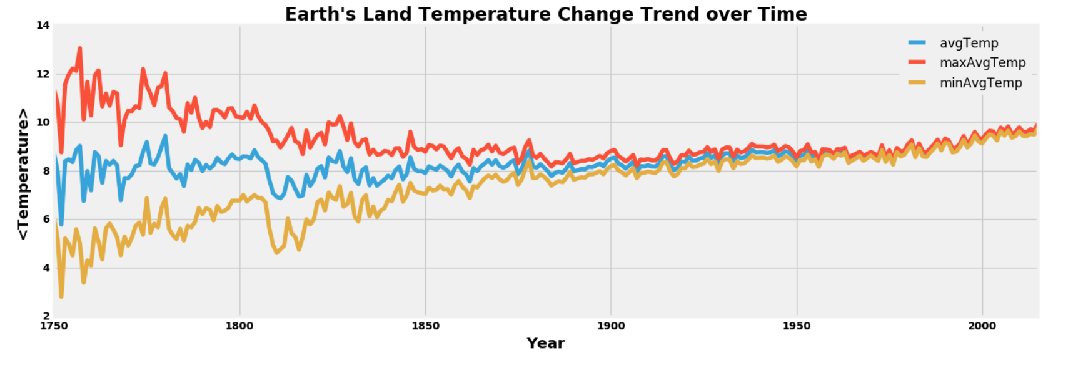
Global Temperature
Annual Trend

Slide 8
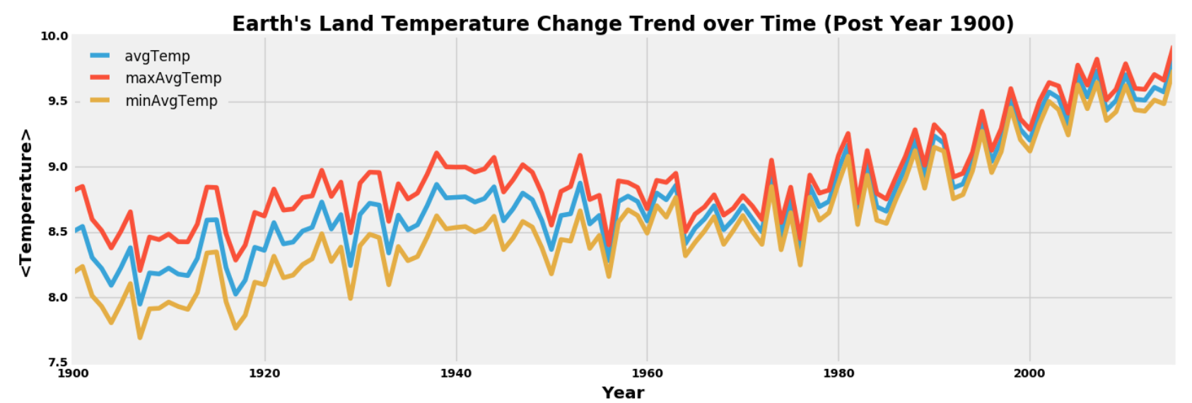
Global Temperature
Annual Trend (Last Century)

Slide 9
CO₂ Emission
Features
Year
Entity (Country Name)
Code (Country Code)
Annual CO₂ Emission (Million Tonnes)
Strategy
Aggregate values on a per-year basis across all entities

Slide 10
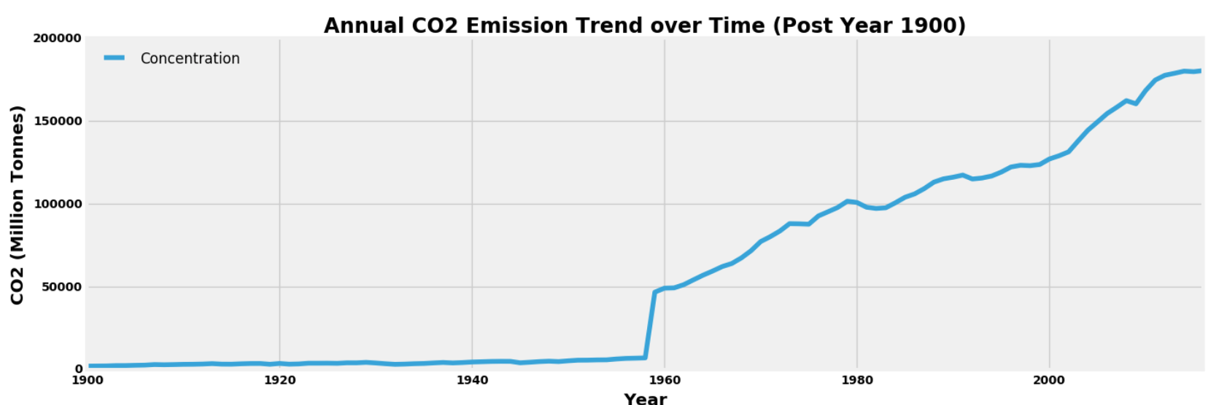
CO₂ Emission
Annual Trend (Last Century)

Slide 11
<OTHER DATASET>
Subtext
Body/bullet text with no bullet icon

Slide 12
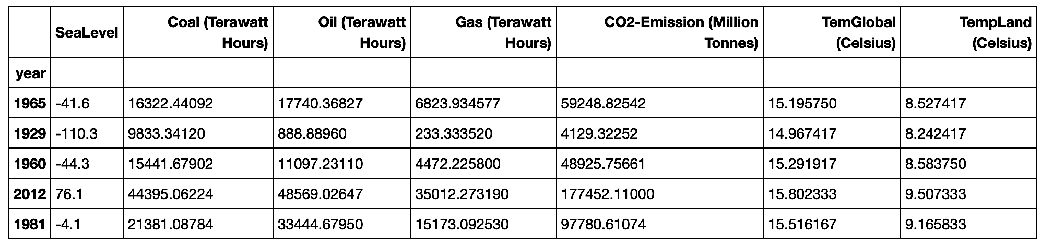
Merged dataset
Features
Notes:
Replace this snapshot

Slide 13
Clustering

Slide 14
Template
Subtext
Body/bullet text with no bullet icon

Slide 15
ClAssification

Slide 16
Template
Subtext
Body/bullet text with no bullet icon

Slide 17
Anomaly Detection

Slide 18
Template
Subtext
Body/bullet text with no bullet icon

Slide 19
Statistical Analysis

Slide 20
Template
Subtext
Body/bullet text with no bullet icon

Slide 21
Natural Disasters

Slide 22
Natural Disasters
Question
Is climate-change causing (some) natural disasters?
What disaster type is most highly correlated with global temperature change trend?
Can we forecast future occurrence of natural disasters based on climate-change?

Slide 23
Natural disasters
Features
Year
Entity
Disaster type
Reports
Number of disaster events reported for the specified entity in a given year

Slide 24
Natural disasters
Exploration
Create separate data-frames for each disaster type
Merge each DF with temperature land data-frame (Outer-join based on year)
Decompose each entity into its trend and noise (EWMA)
Understand how each entity (and its trend) correlates with global temperature value (and its trend)

Slide 25
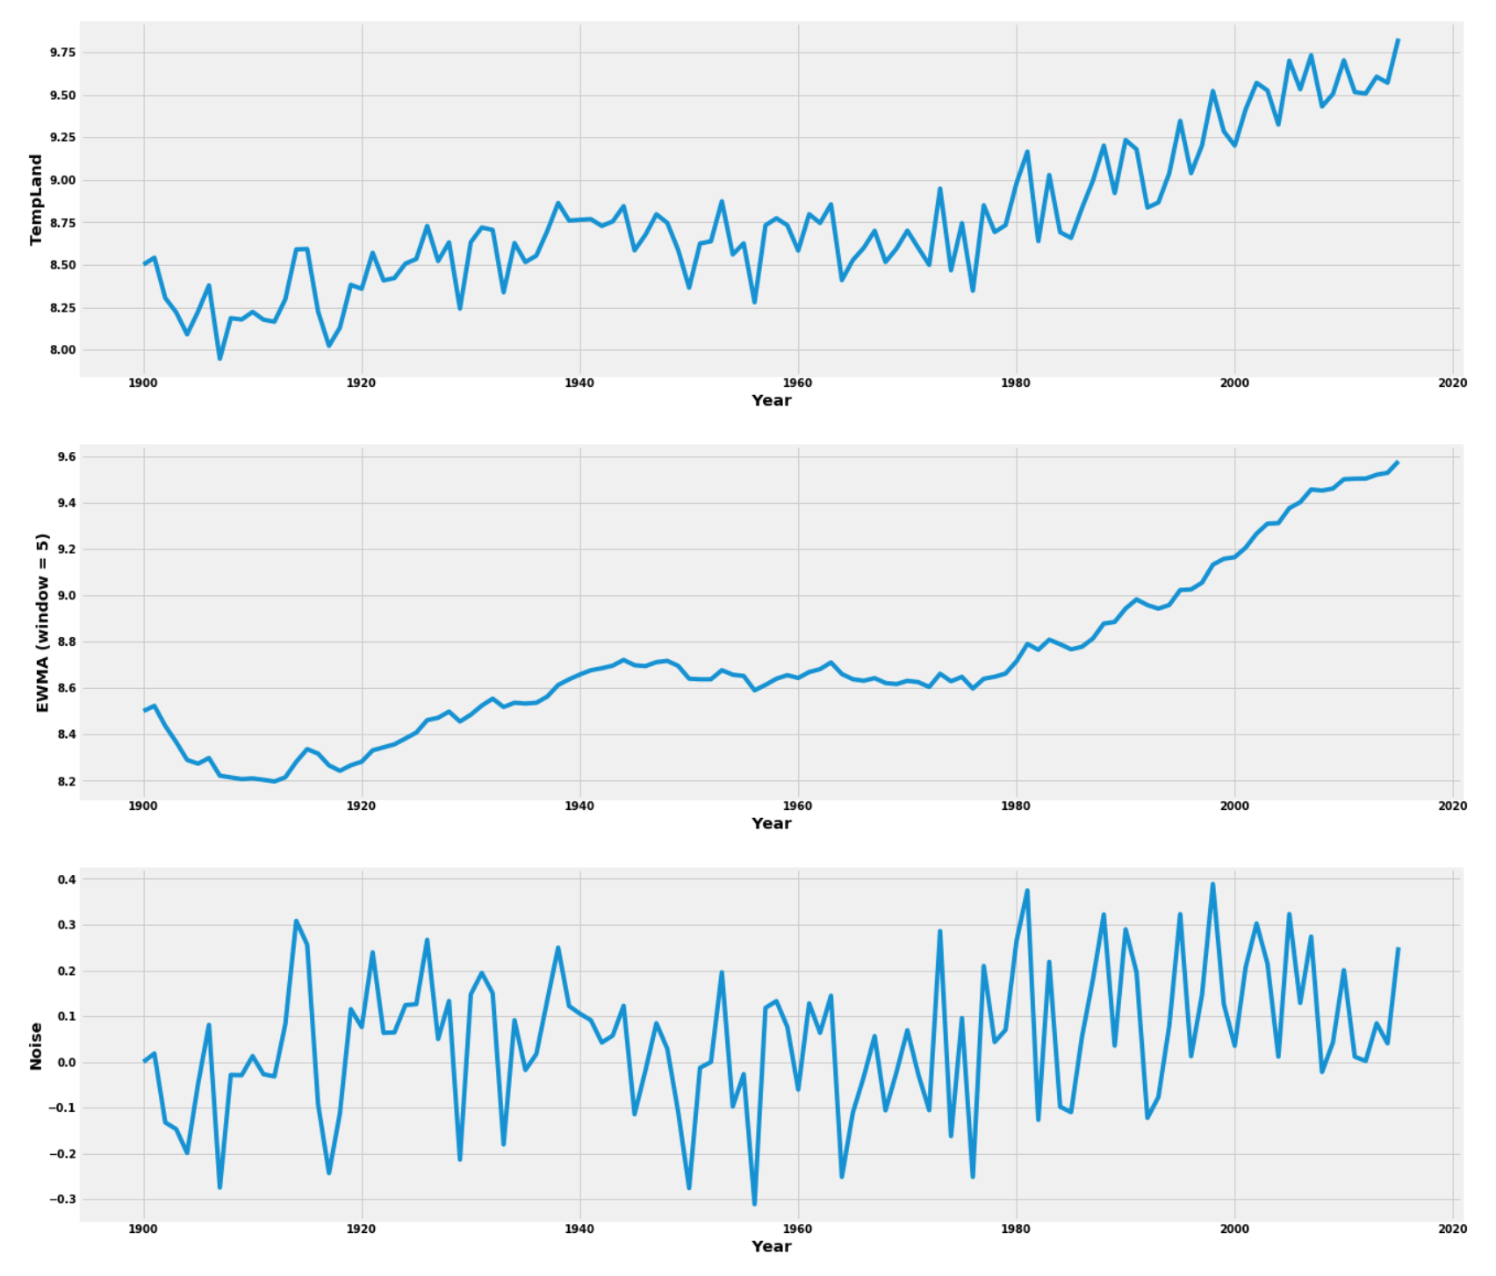

Slide 26
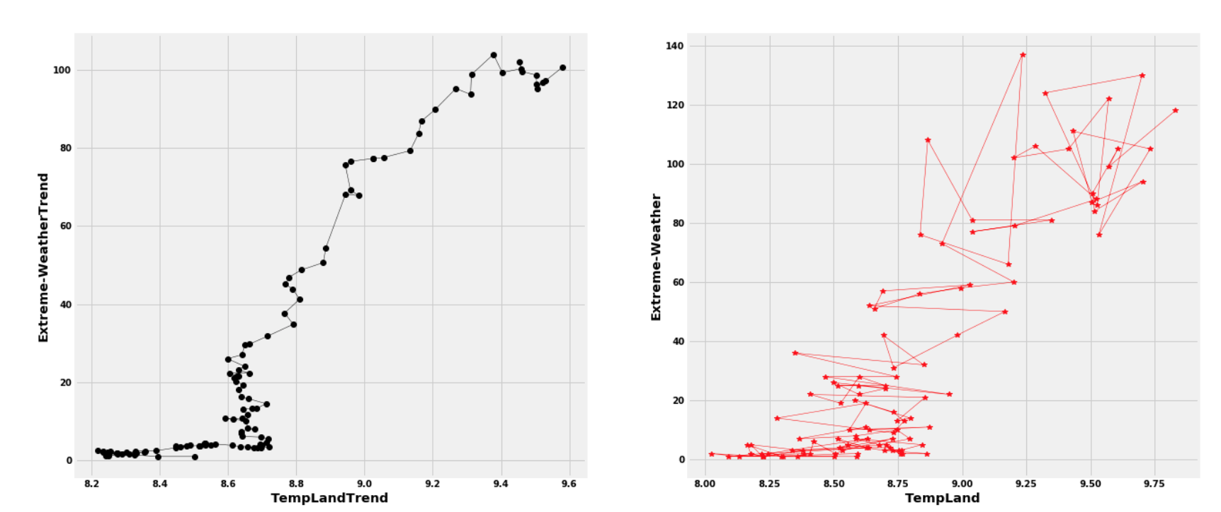
Natural disasters
Raw Data vs Trends

Slide 27
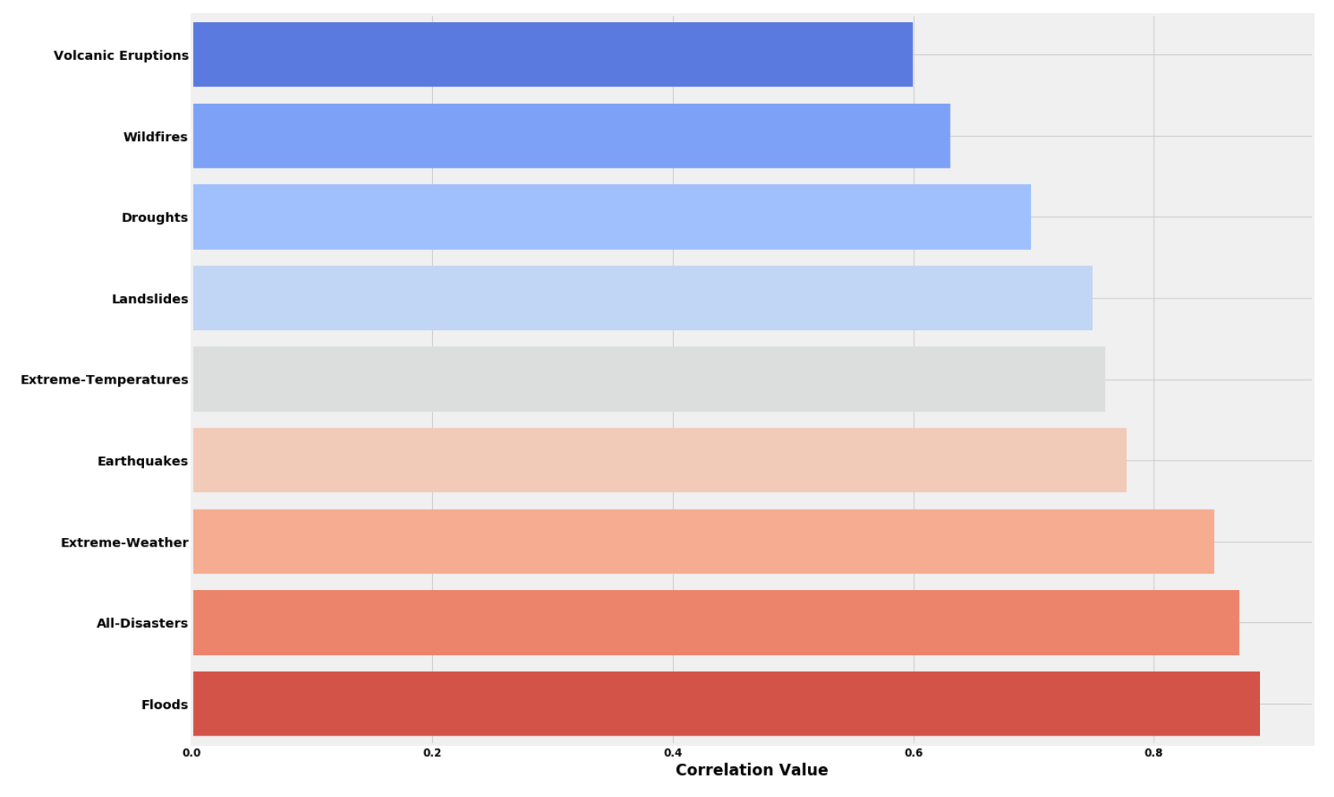
Natural disasters
Correlation with Global Temperature Change

Slide 28
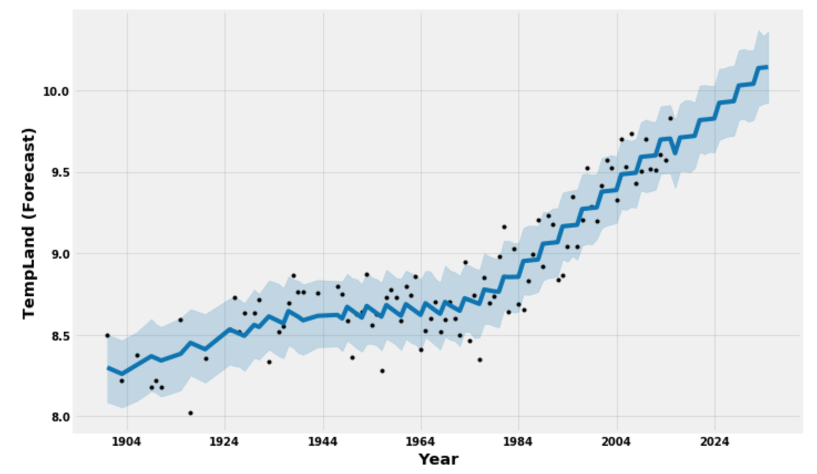
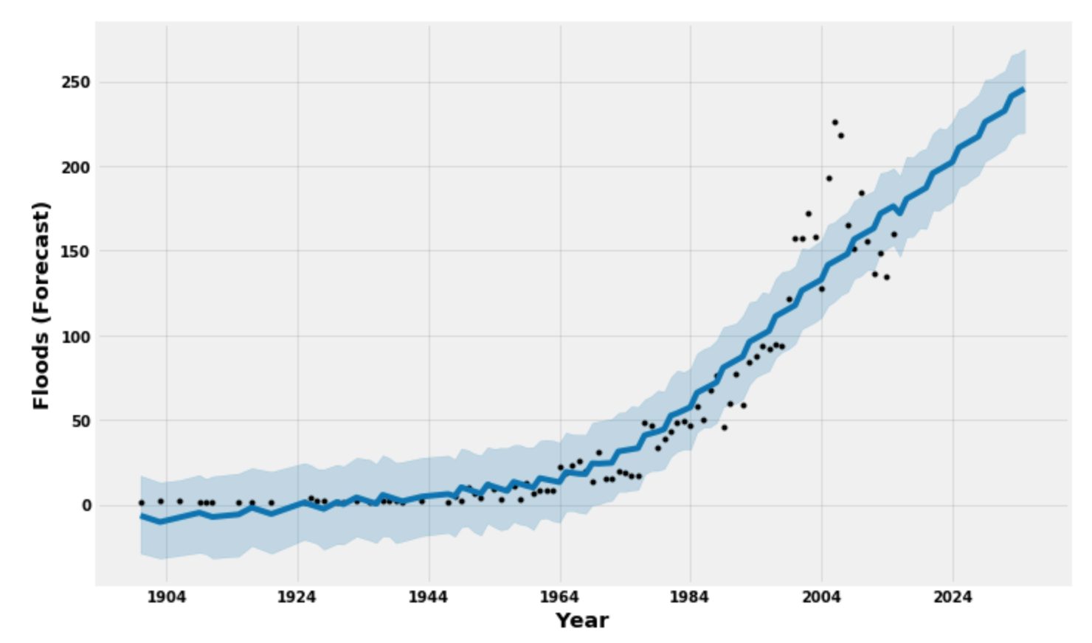
Natural disasters
Forecasting with FbProphet

Slide 29
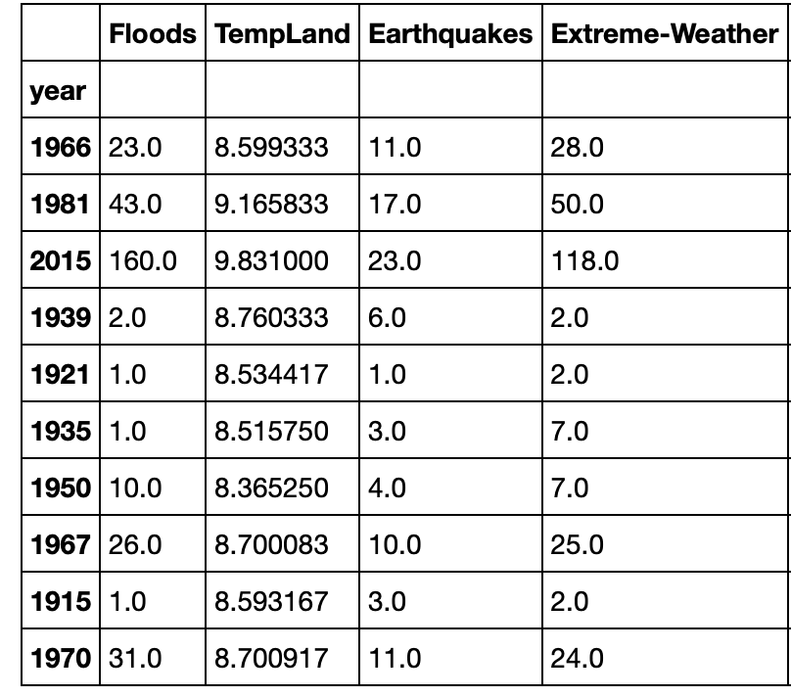
Natural disasters
Classification
Create a new data-frame
Features: Global Land Temperature, Earthquakes, Extreme-Weather, Floods
Goal: Can we classify floods taking other attributes as features?

Slide 30
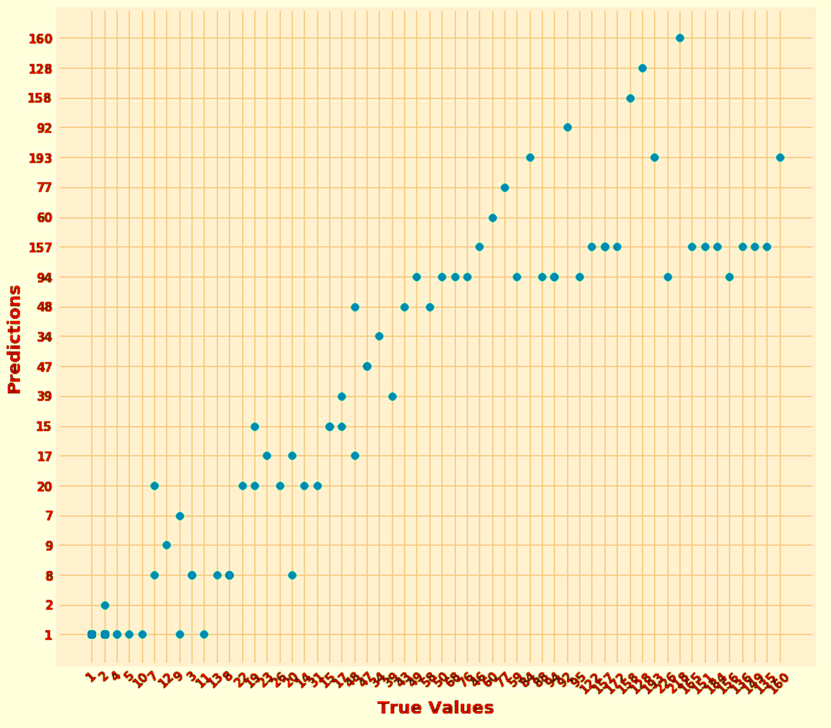
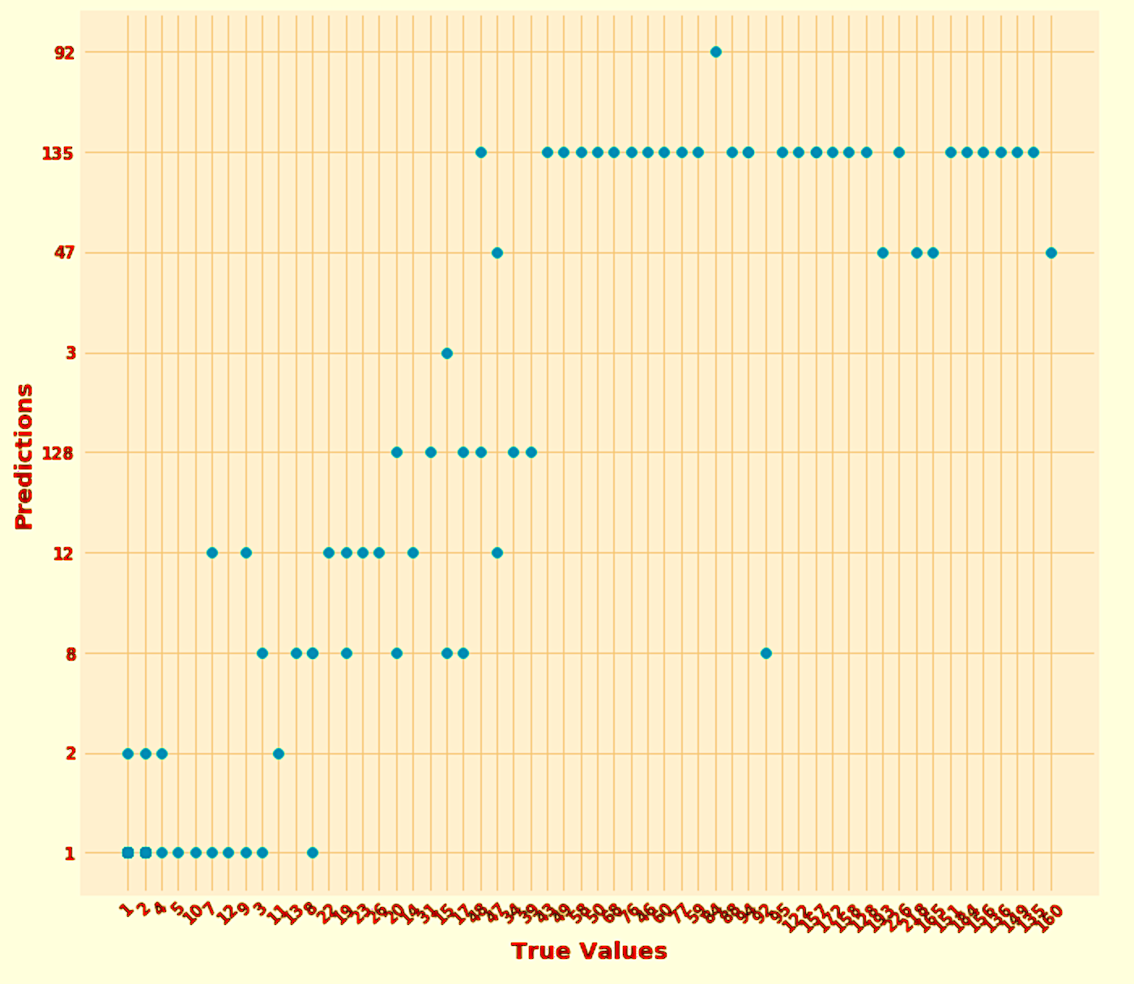
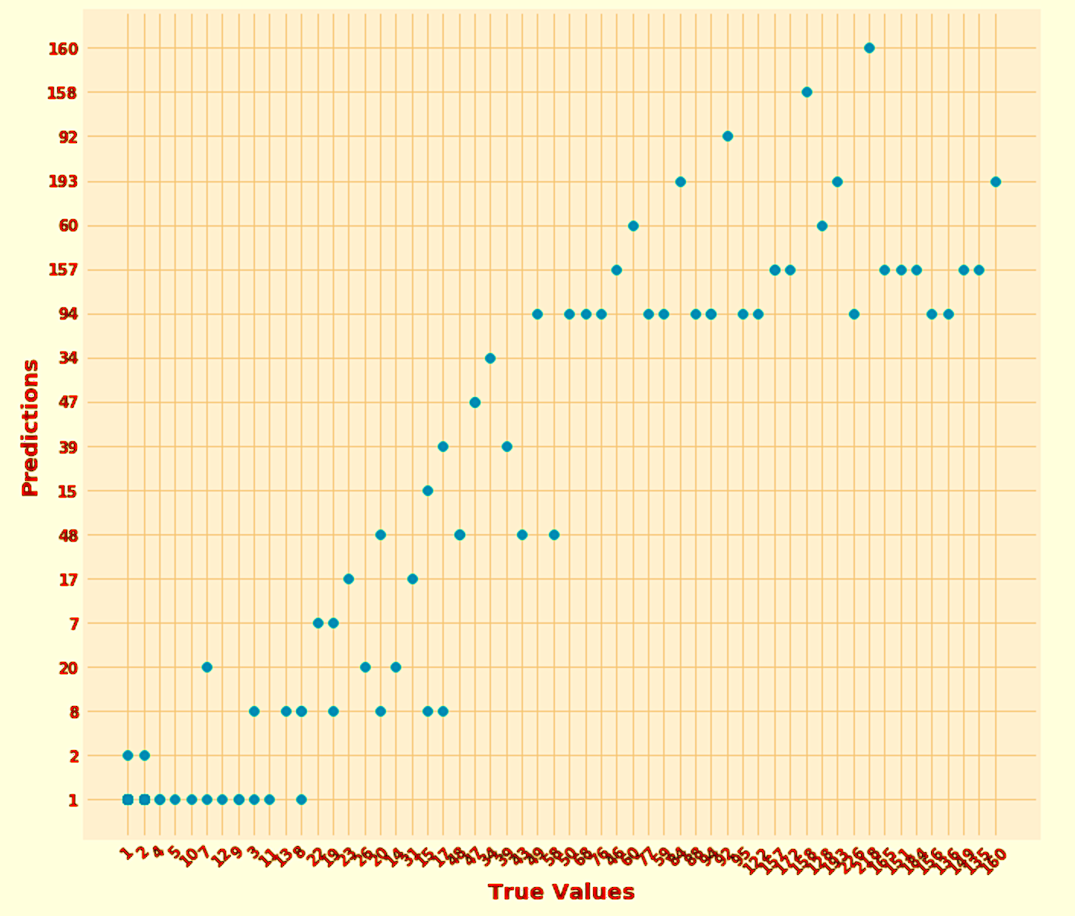
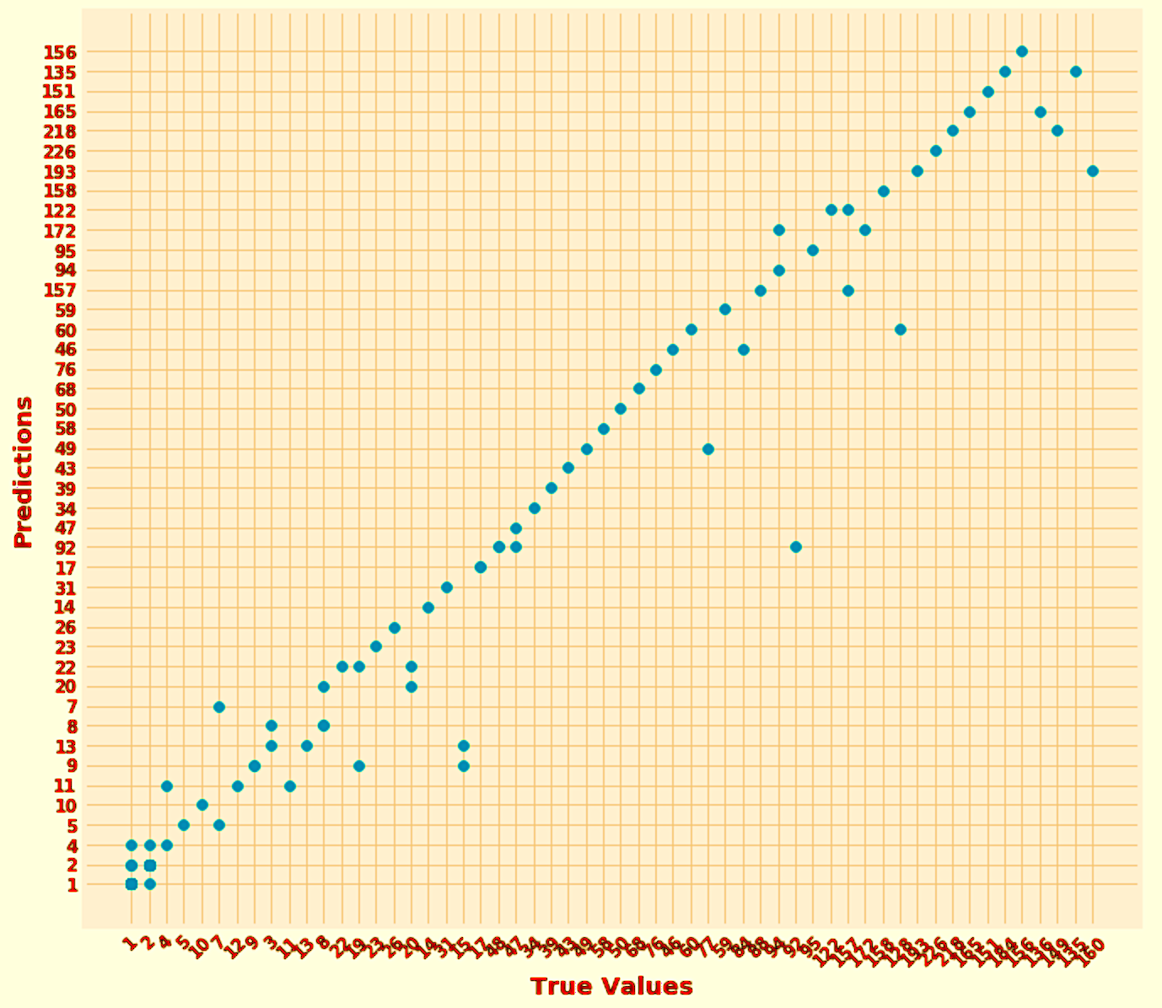
Natural disasters
Classification
Multinomial Naïve-Bayes
Accuracy: 45%
Linear SVC
Accuracy: 30%
Logistic Regression
Accuracy: 41%
Random Forest
Accuracy: 74%

Slide 31
ConClusion

Slide 32
Learning outcomes
EECS-731
Body/bullet text with no bullet icon

Slide 33
Questions?

Slide 34

title
Subtitle
Text goes here
Text goes here
Text goes here
Text goes here

Slide 35
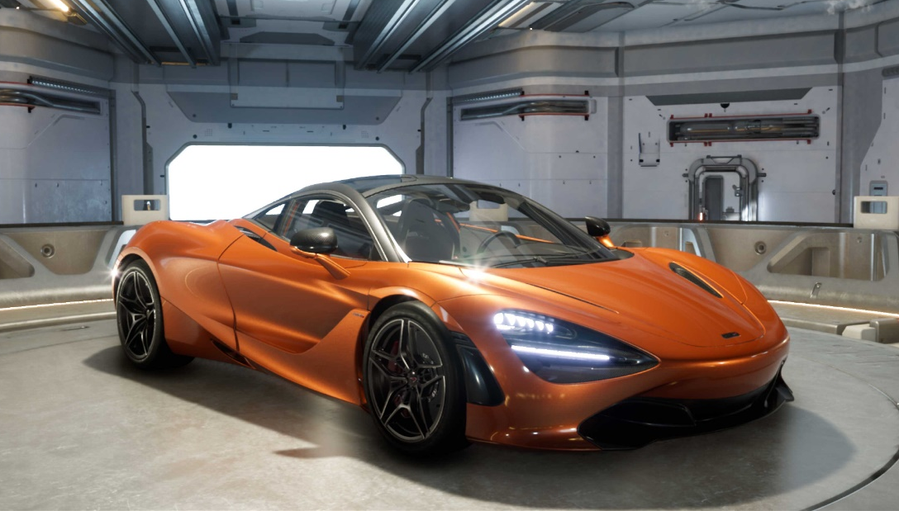
Imagery, chart and text
Subtitle
Use body text sparingly on slide types that include other information, such as, an image and data/chart. Too much on the slide might be hard for the viewer to take in.

Slide 36
“ Quoted text example goes here. Trebuchet, 42 pt. Use with shorter (headline type) quotes.”
Quote Source, Trebuchet 16 pt

Slide 37
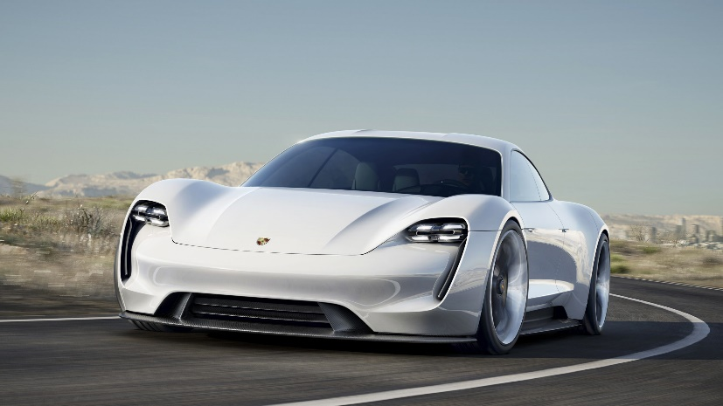
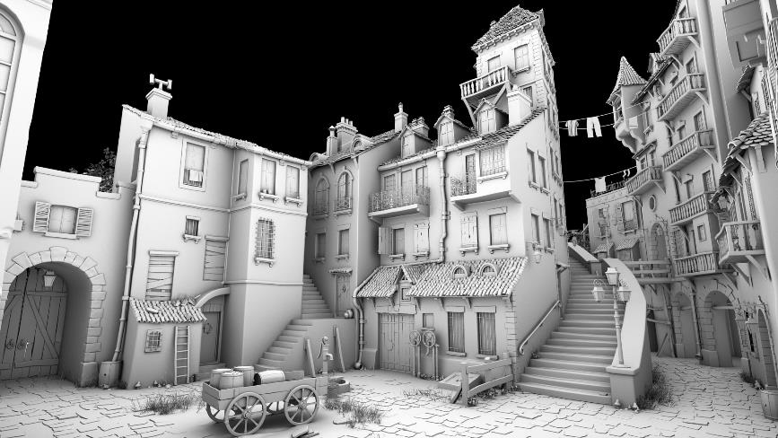
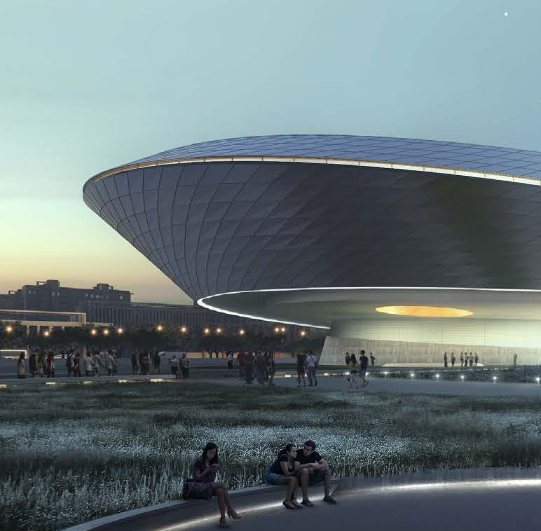
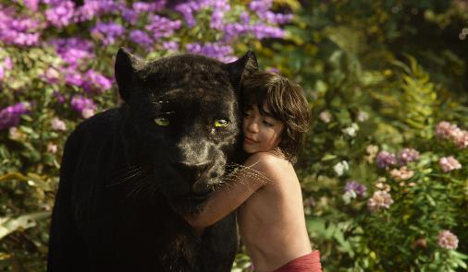
Timeline with images
Text Goes Here
Text Goes Here
Text Goes Here
Text Goes Here
xxxx
xxxx
xxxx
xxxx
Source: Source information is 8 pt, italic

Slide 38
World map
<Explanation>
Helsinki
Santa Clara
Tokyo

